Slide 1
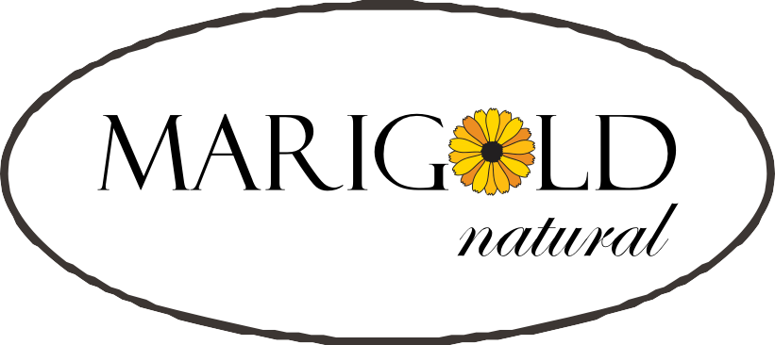
MISSION - -
producing and selling
SUPERIOR QUALITY NATURAL PRODUCTS
conforming to the
HIGHEST INTERNATIONAL STANDARDS
PP «KALYNTORG»

Slide 2
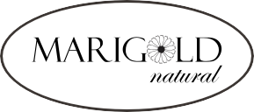
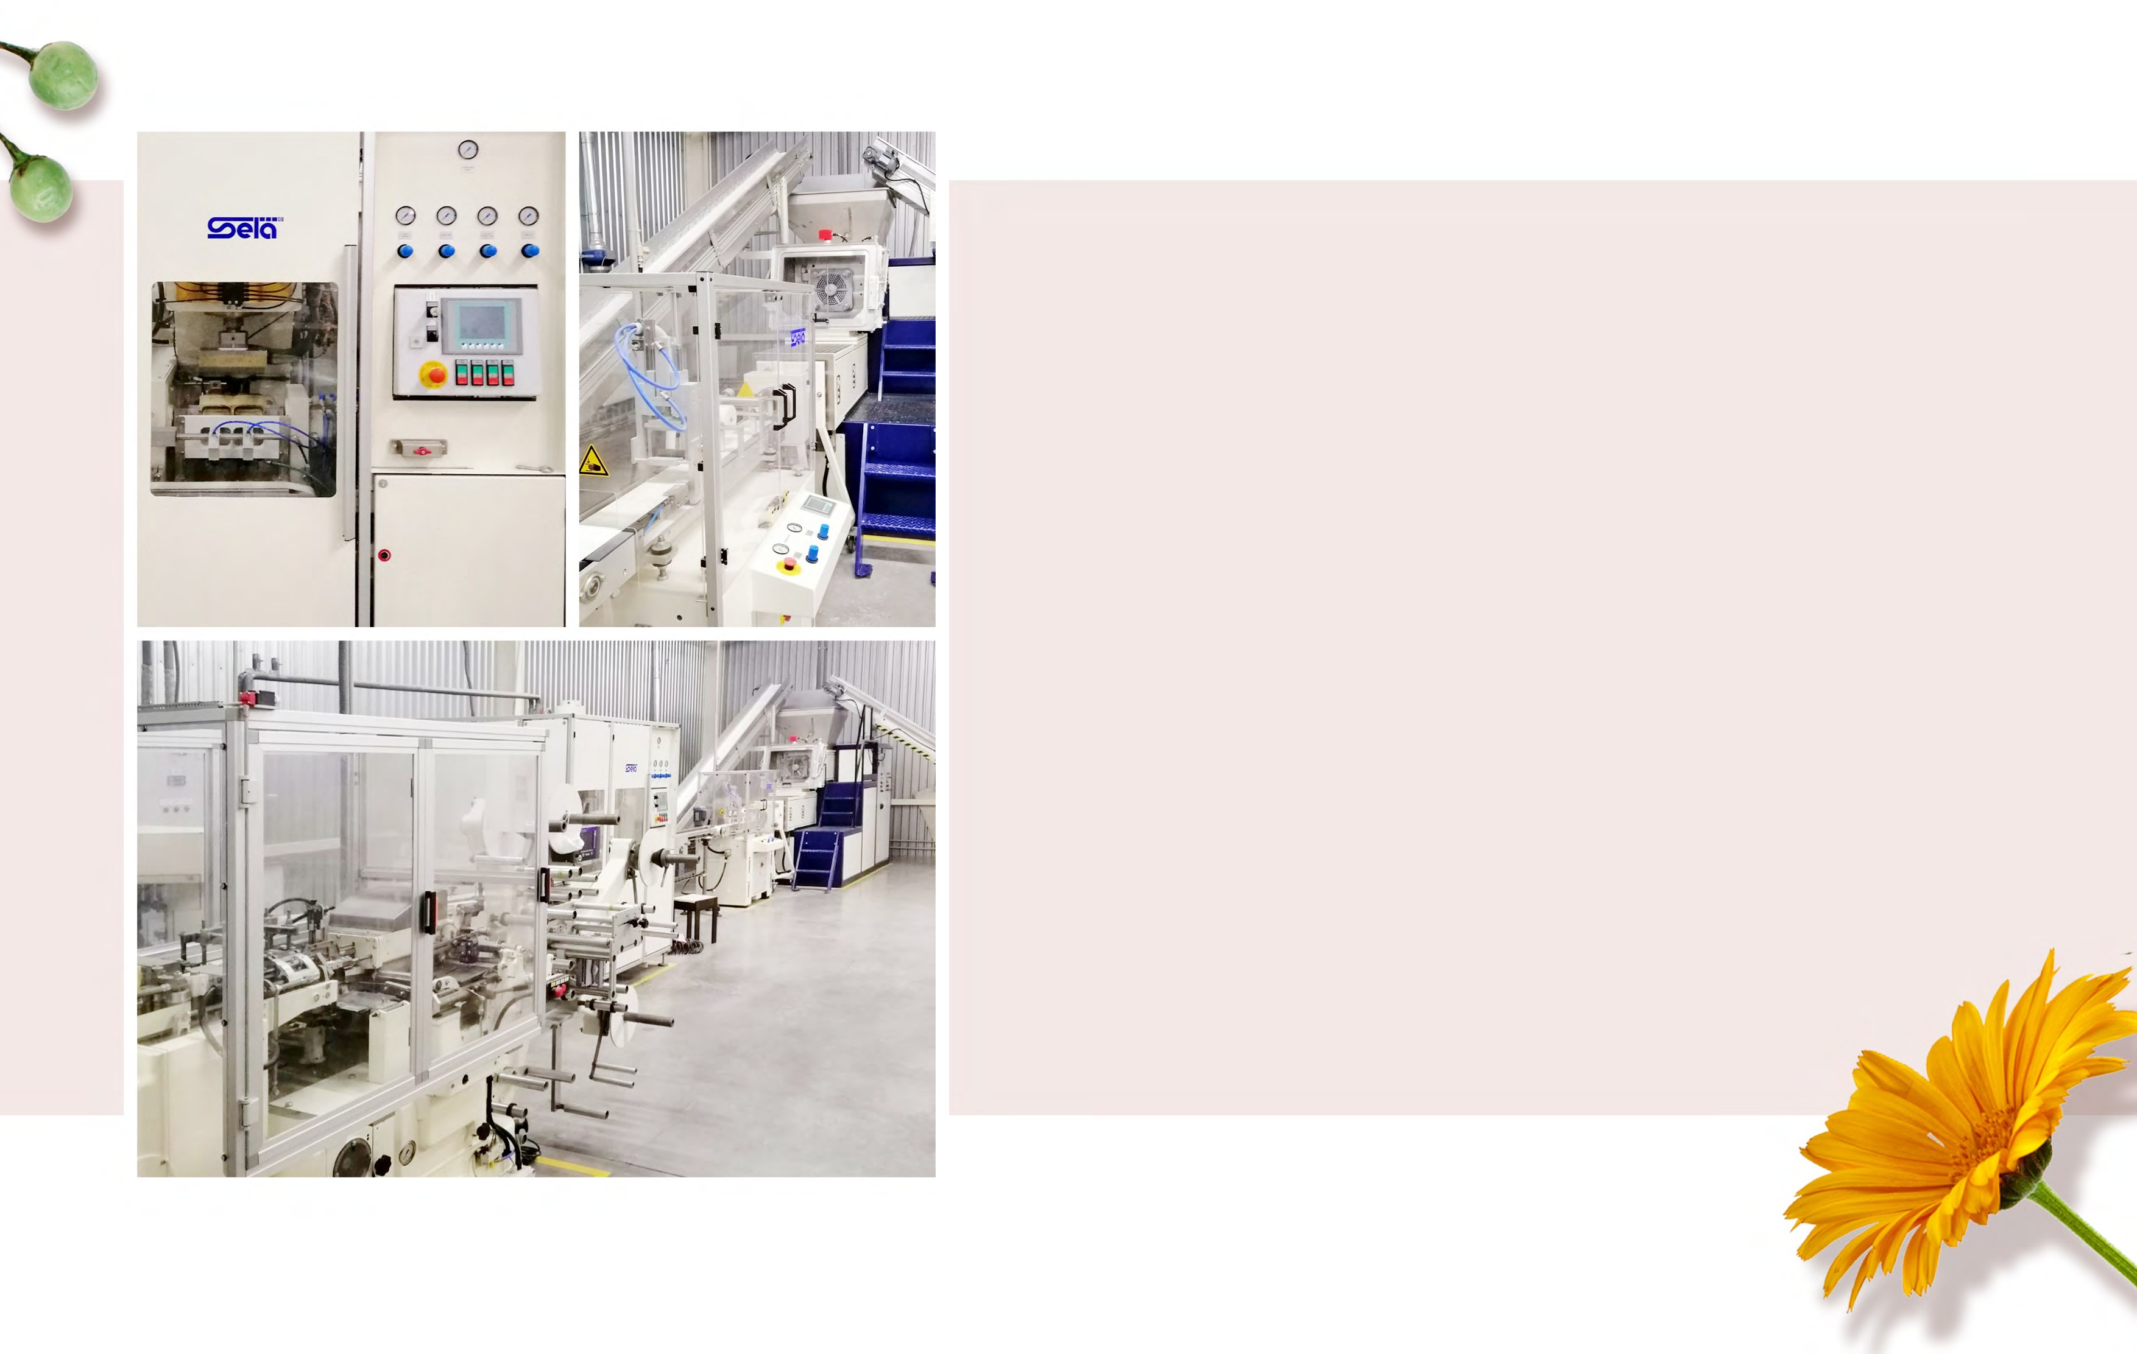
DATE OF ESTABLISHMENT – 2016
PRODUCTION LINE:
made in Germany
PACKAGING MACHINES:
Italy Ukraine
QUANTRIES – Suppliers of raw materials:
Malaysia; Switzerland; Germany;
Finland (HUHTAMAKI GROUP);
The USA (HLP Klearfold);
China (Hong Kong).

Slide 3
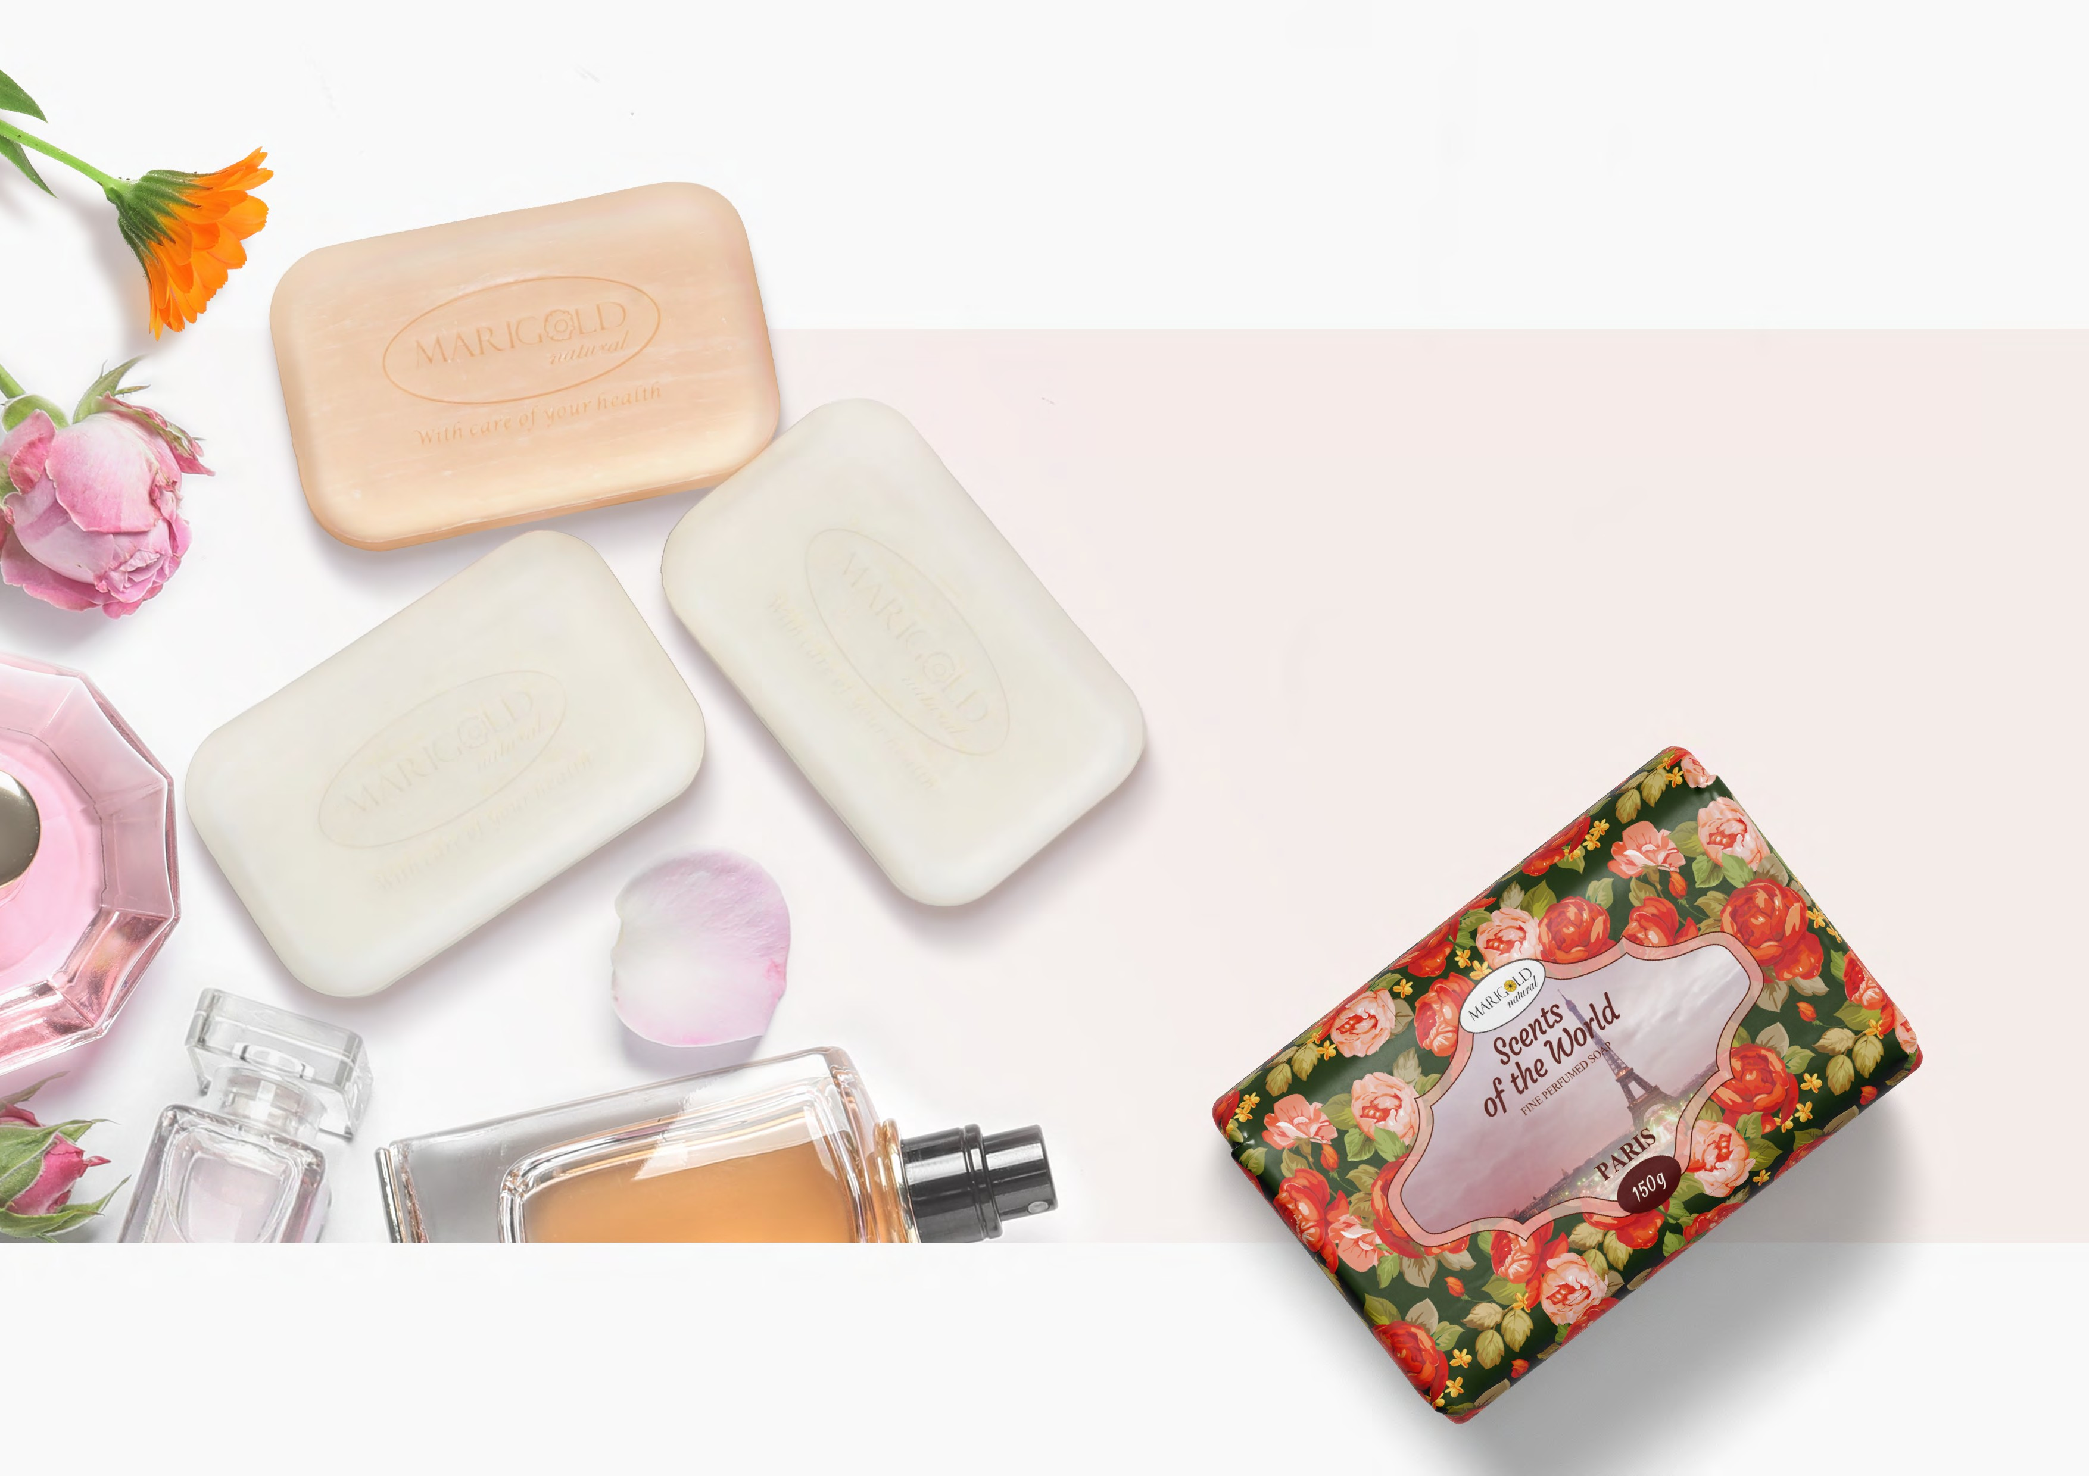
DEVELOPED ESPECIALLY FOR US
peculiar perfumed compositions bright and qualitative packaging

Slide 4
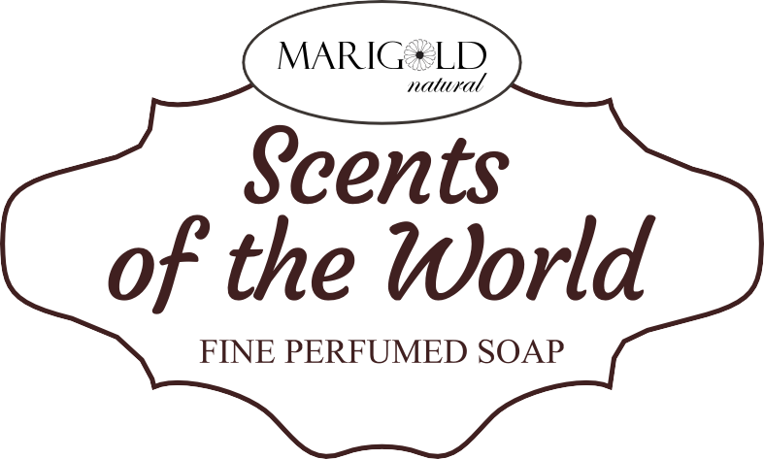
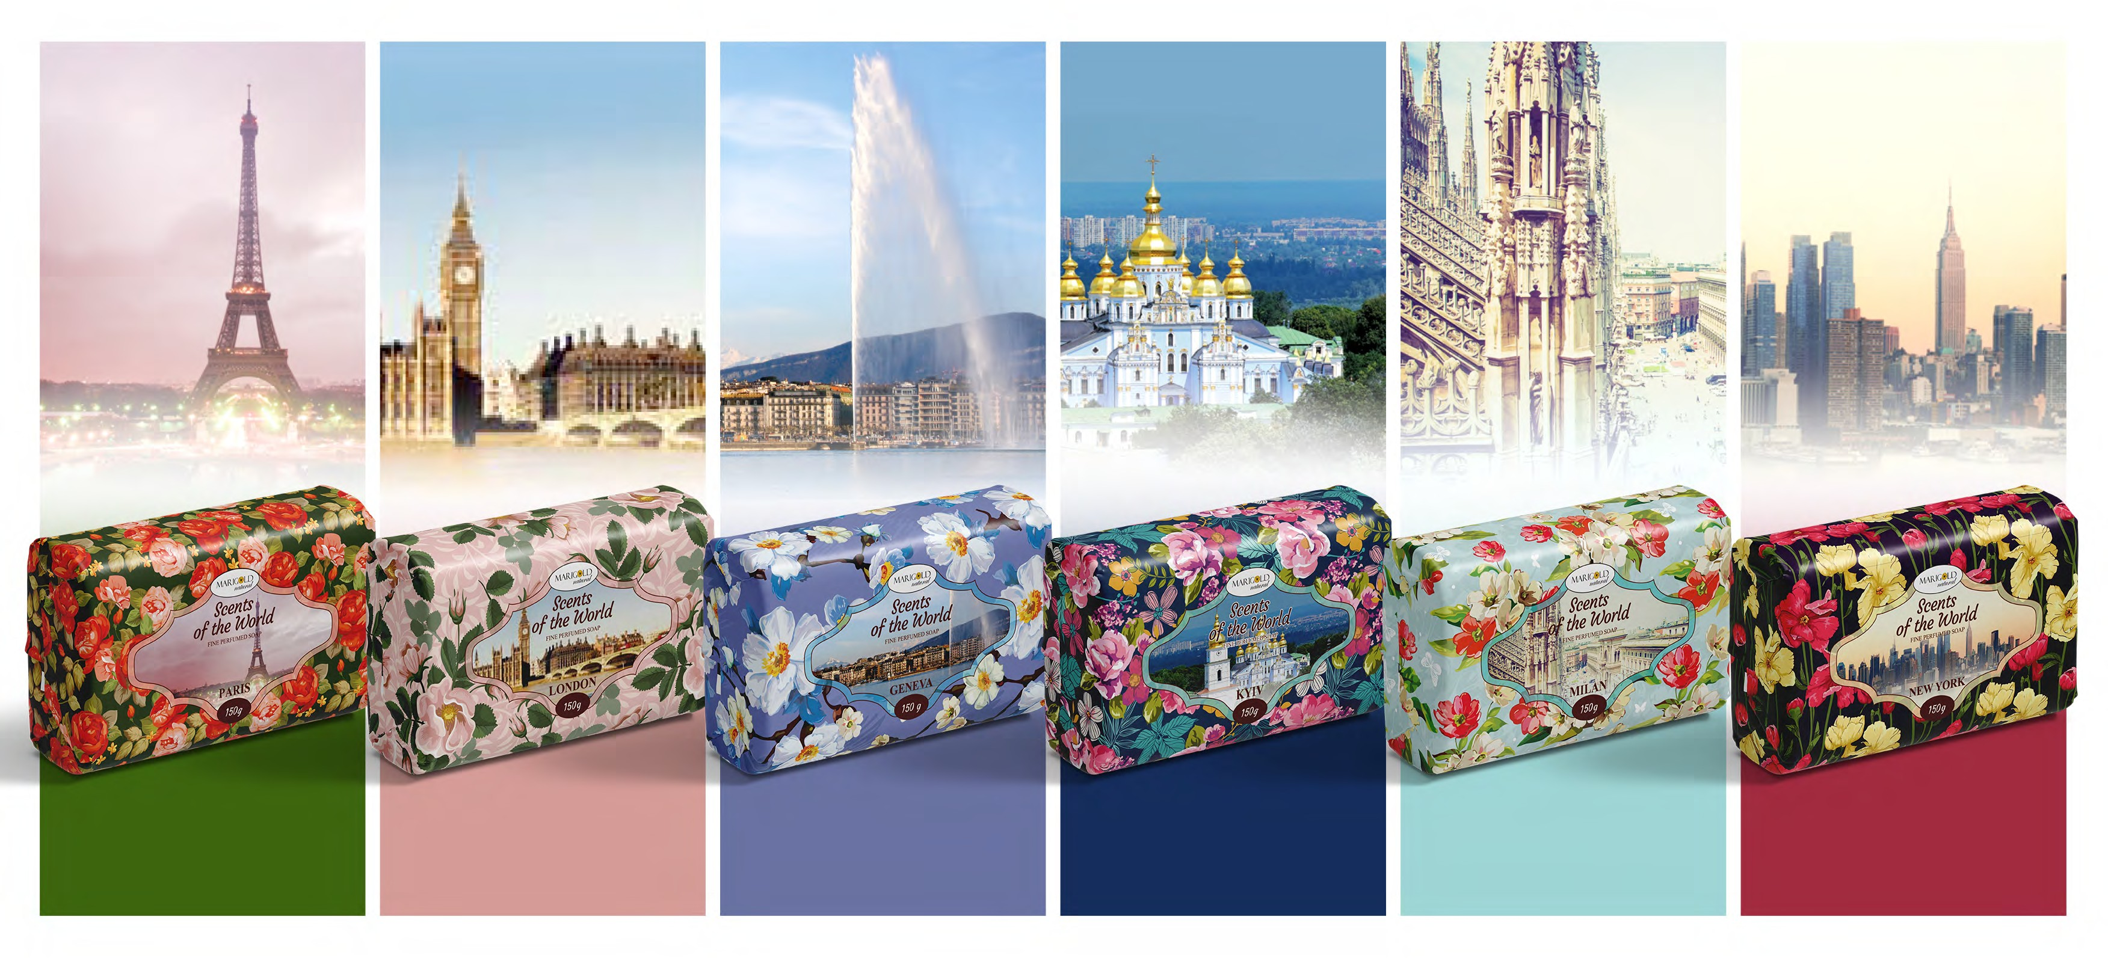



THE SCENT OF A SOAP REFLECTS THE SPECIAL ATMOSPHERE OF EACH CITY
Net weight - 150 g

Slide 5
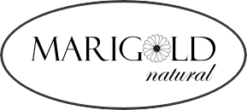
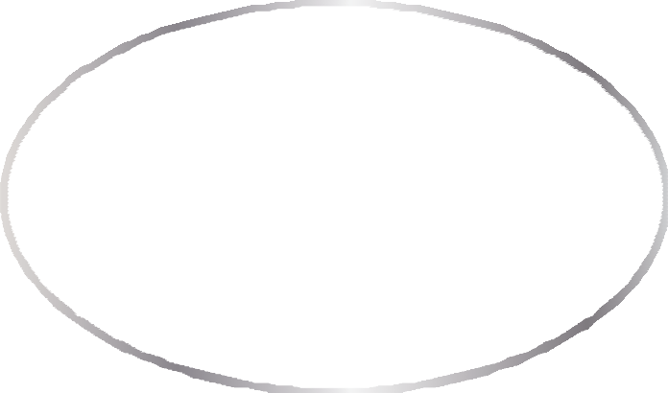

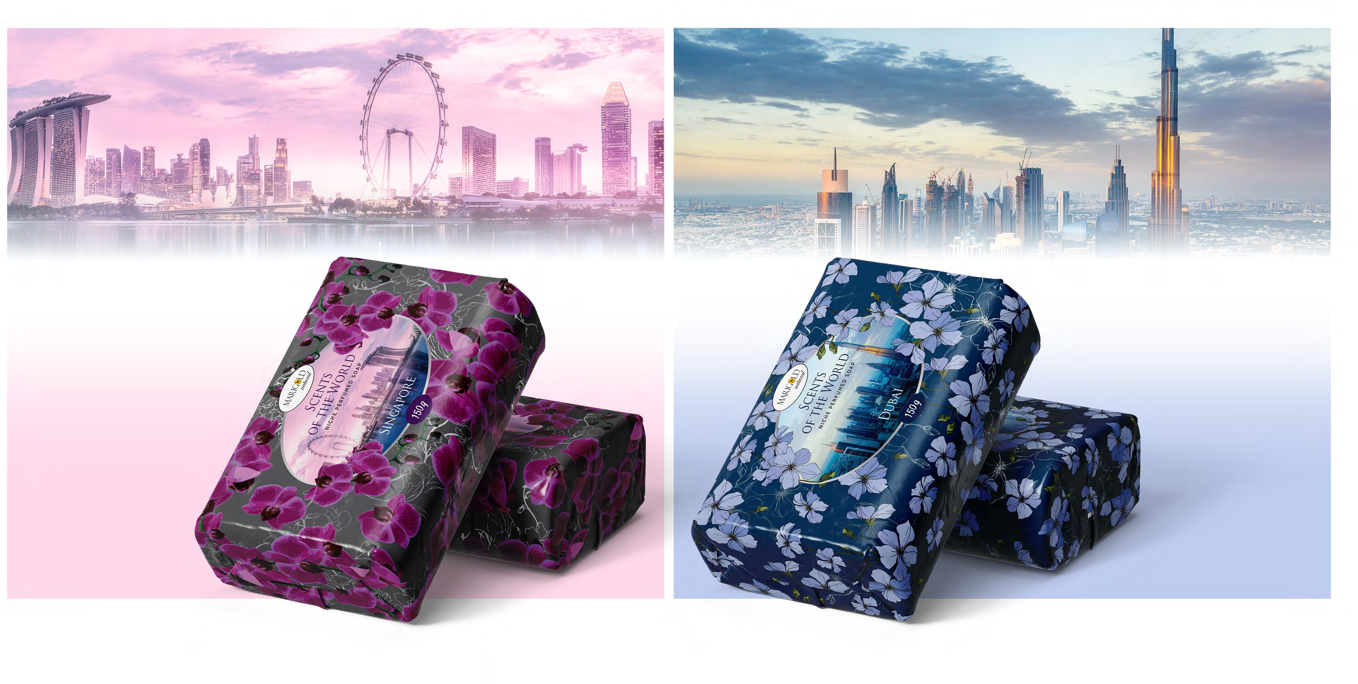









THE SCENT OF A SOAP REFLECTS THE SPECIAL ATMOSPHERE OF EACH CITY
Net weight – 150 g

Slide 6
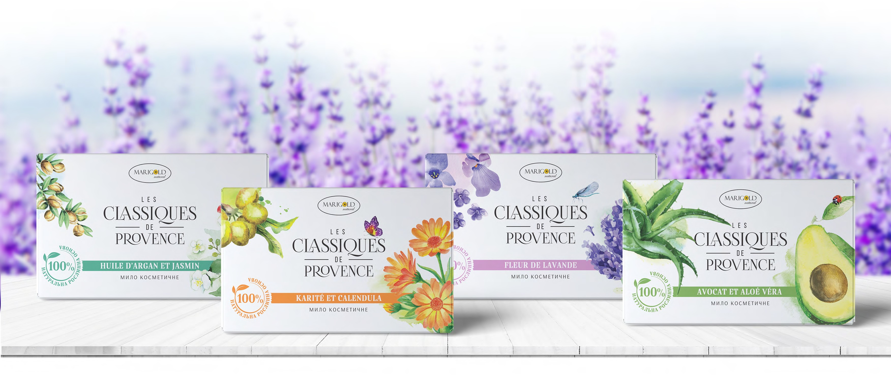
NATURAL COSMETIC SOAP ENRICHED BY UNIQUE NATURAL OILS and PRODUCED IN ADHERENCE TO ANCIENT RECIPES OF PROVENCE REGION
Net weight - 90 g

Slide 7
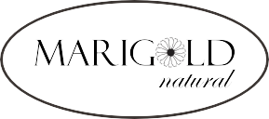





OUR UNIQUE ADVANTAGES :
Frontline German made equipment
Total Fatty Matter
(TFM) – 79%
Produced solely from vegetable oils
The unique composition of soap
WE CONSIDER THE MANUFACTURING PROCESS OF OUR PRODUCTS TO BE TRUE ART…

Slide 8



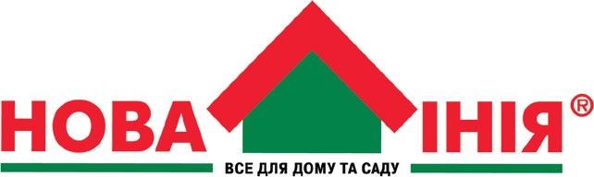

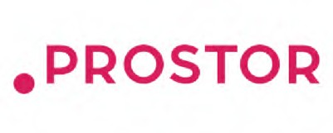
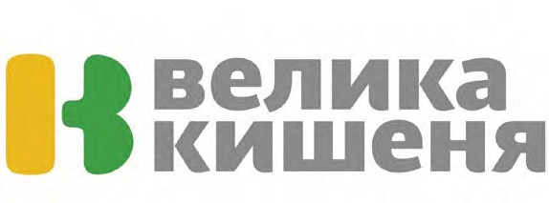



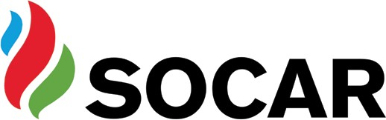

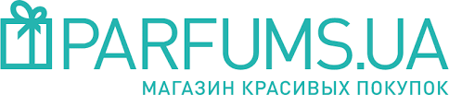
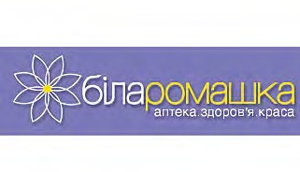


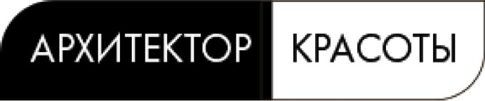
PRESENCE IN UA RETAIL CHAINS:

Slide 9
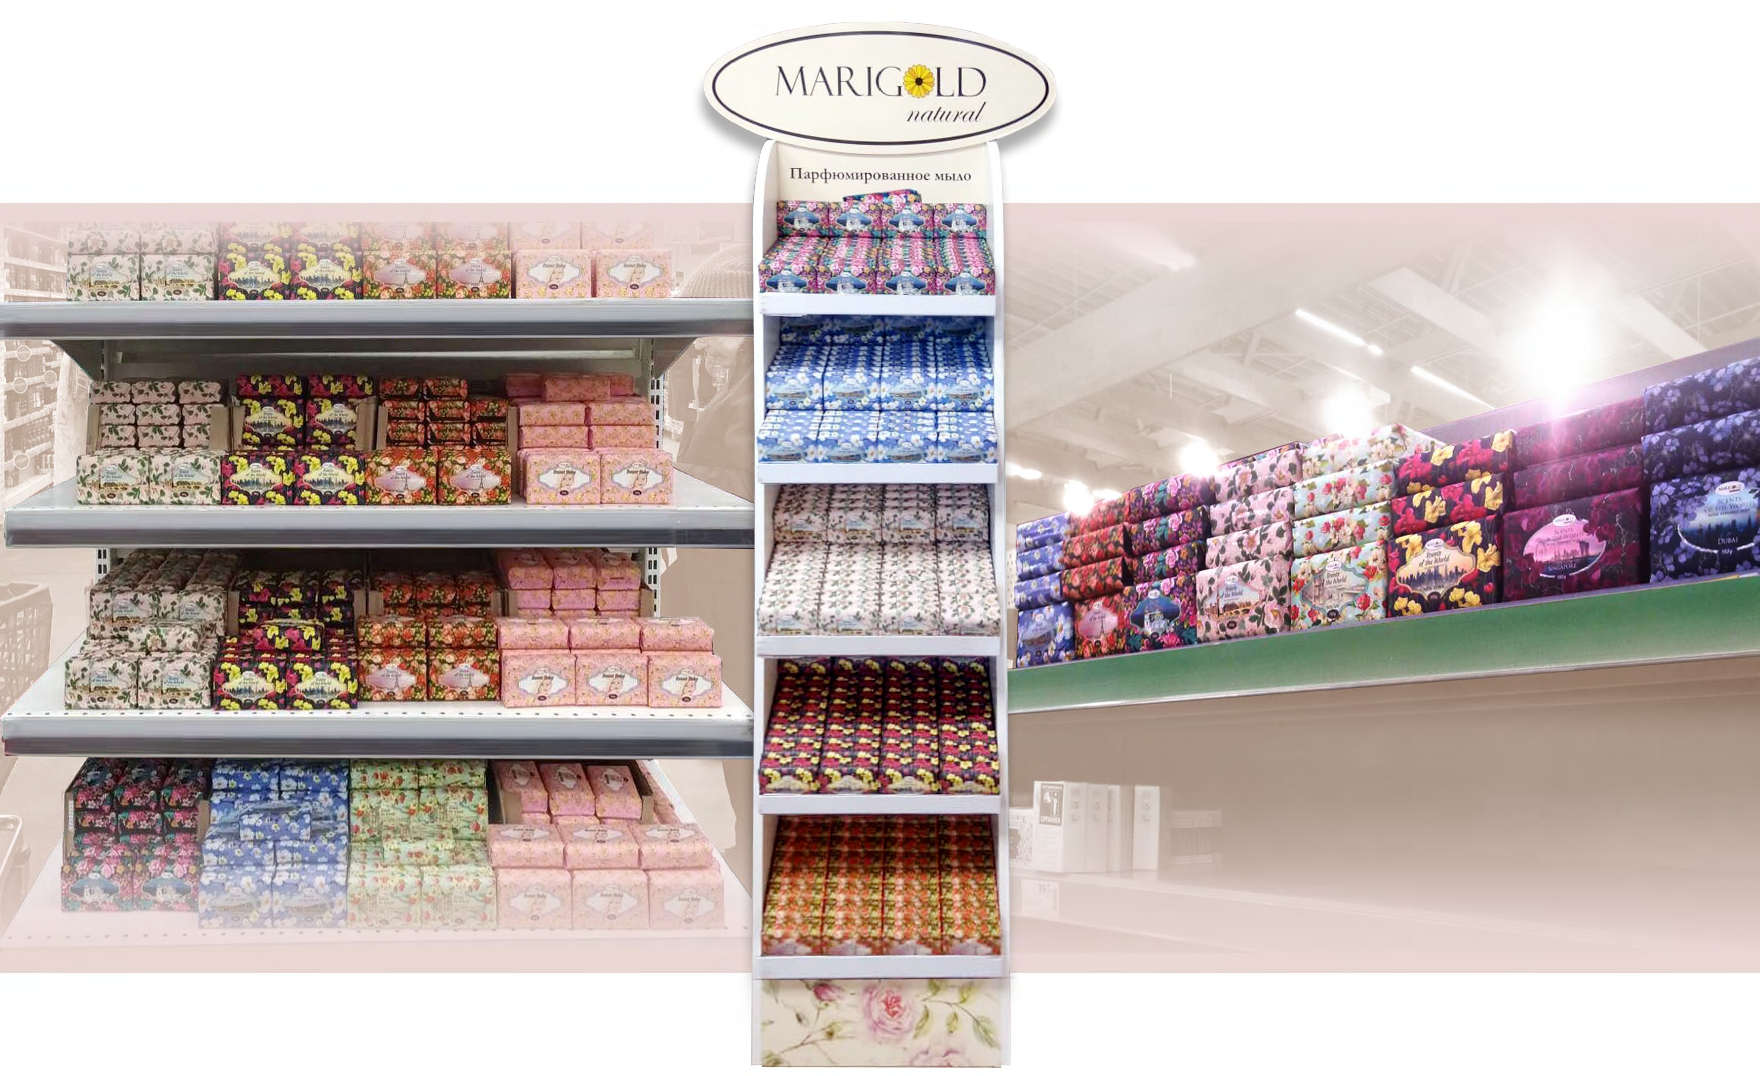
MORE THAN 2000 STORES

Slide 10
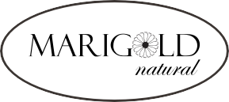
THANK YOU FOR YOUR ATTENTION!
O3150, No.519, st.Antonovicha 172, Kiev, Ukraine.
Tel: +38 044 290 02 90, +38 044 290 02 92
mob: +38 050 356 75 75
Ms. TETIANA PONOMARENKO
Managing Director,
PP “KALYNTORG”
marigold-kiev@ukr.net, | info@marigoldnatural.com
www.marigoldnatural.com

