Slide 1
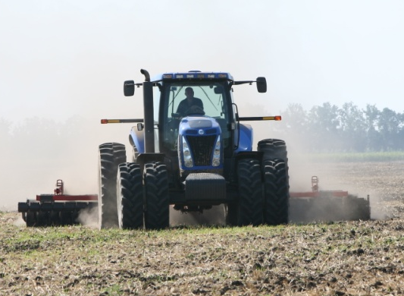
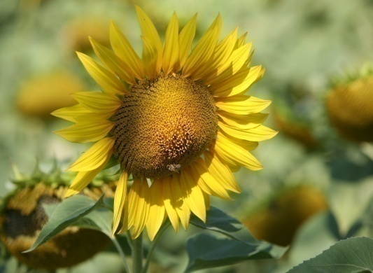
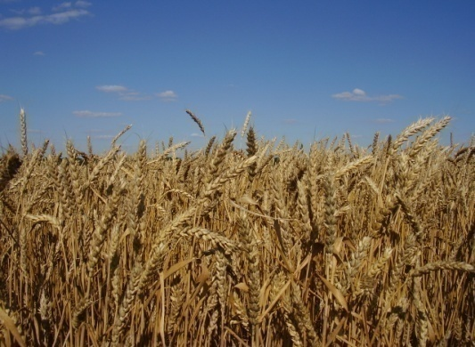
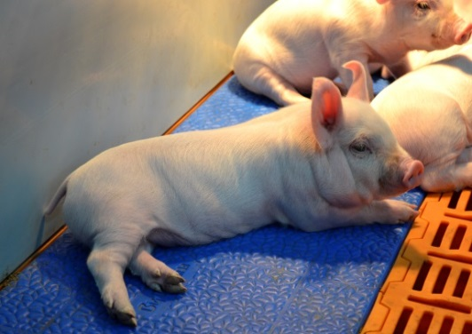

KSG Agro
Corporate presentation
June 2019

Slide 2
Content
Sergiy Kasianov, Chairman of the Board | 2
KSG Agro: Land bank | 3
Farming: Crop production & sales | 4
Food processing: Own meat processing plant | 5
Pig breeding: facts | 6
Fuel pellet & energy production: facts | 7-9
Pig breeding business: new plans ahead | 10
Innovations for Increasing Operational Efficiency | 11
Oil processing | 12
Availability of modern infrastructure | 13
Abbondanza – our Swiss trading company | 14

Slide 3
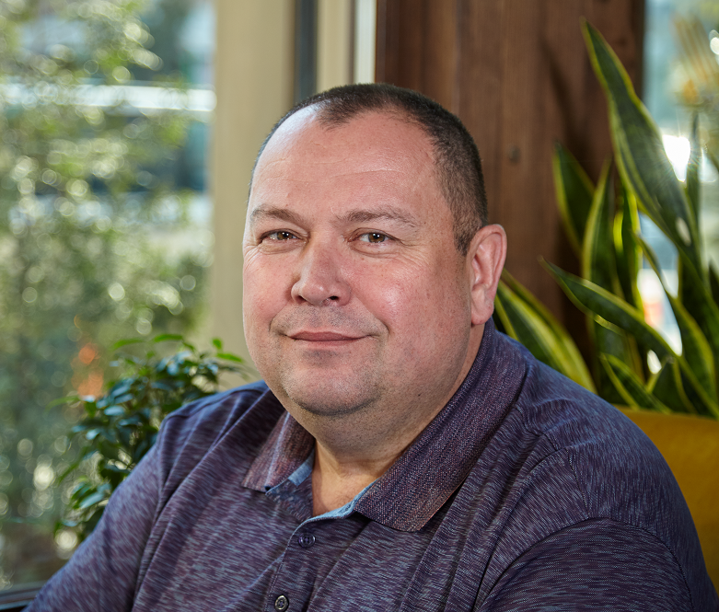
KSG Agro: Sergiy Kasianov, Chairman of the Board
Chairman of the Board and the majority shareholder of KSG Agro
Former Member of the Regional Committee for Economic Reforms of the Dnepropetrovsk Regional State Administration and Advisor to the Governor of Dnepropetrovsk region on issues of attracting investments
In 2005, Sergey Kasyanov headed the Dnepropetrovsk Regional State Administration
Member of Parliament between 2002 and 2006, Sergey served as the Chairman of the Commission for Joining World Trade Organization, under Sergey’s management Ukraine adopted necessary laws and could become the member of WTO in 2002.
Chairman of the Subcommittee on Co-ordination of Cooperation with the EU, the WTO, the BSEC (Organization of the Black Sea Economic Cooperation) of the Ukrainian Parliament’s Committee on European Integration
Founder and CEO of Olvia Beta, the Ukrainian-Turkish production and trading company eventually sold to Procter and Gamble for USD100 mln in 2002

Slide 4
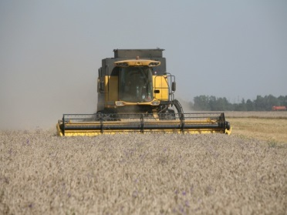
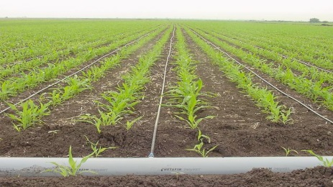
KSG Agro: Land bank
21
28
21
Land bank controlled by KSG Agro, thousand ha

Slide 5
Farming: Crop production & sales
Crop rotation, ths hectares
Crops production, ths tons
 | 2019 | 2018 | 2017 | 2016
Sunflower | 7,4 | 10.2 | 15.9 | 15.8
Wheat | 8,3 | 9.3 | 7.9 | 6.6
Barley | 2,3 | 2.6 | 3.2 | 2.7
Corn | 2,1 | 1.7 | 1.2 | 0.4
Rapeseed | 1,5 | 2.5 | 1.3 | 0.8
Other (include fallow land) | 1 | 1.1 | 3.6 | 6.8
Total | 22,6 | 27.4 | 33.1 | 33.1
 | 2019 | 2018 | 2017
Sunflower | 19 | 23.5 | 18.4
Wheat | 11 | 18.8 | 19.7
Rapeseed | 1,1 | 5.8 | 0.8
Barley | 4 | 3.1 | 5.2
Corn | 5,4 | 1.0 | 1.6
Total | 38 | 52.2 | 45.7
Main Crops sales
 | 2019 | 2018 | 2017 | %
Sunflower
Sales, USD mln | 5,5 | 5.7 | 4.8 | 20%
Sales, thousands tons | 19 | 19.0 | 16.0 | 18%
Average price, USD/ton | 291 | 304 | 301 | 1%
Wheat
Sales, USD mln | 1,6 | 2.6 | 2.4 | 10%
Sales, thousands tons | 11 | 16.0 | 17.0 | (5)%
Average price, USD/ton | 147 | 163 | 139 | 17%

Slide 6
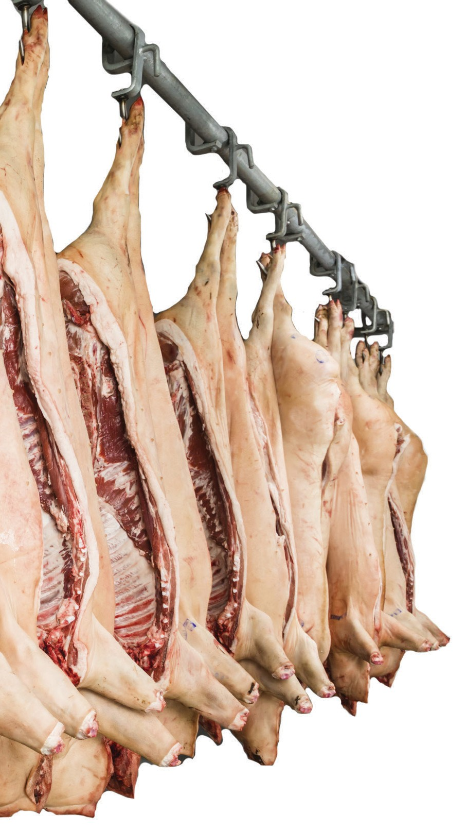
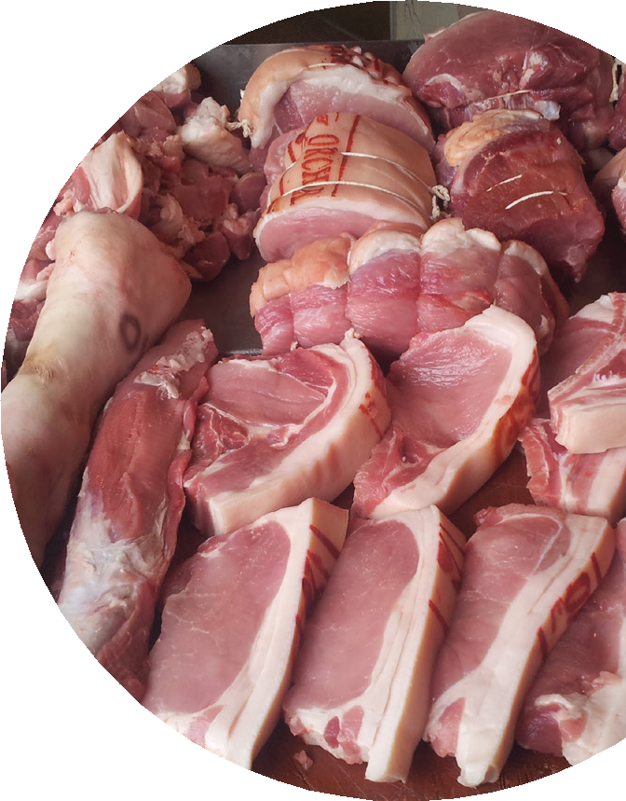
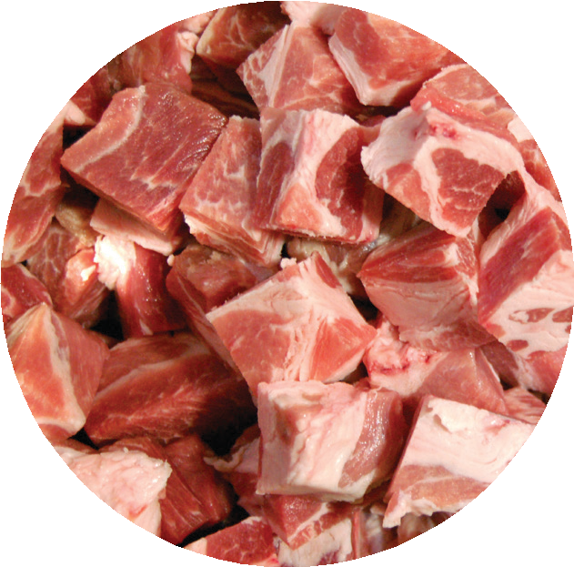
Food processing: Own meat processing plant
  Own processing reduces dependence on price volatility
  Ukrainian meat market has a great growth potential
Annual per capita meat consumption during 2006–2010 and forecast to 2021
97 97 ₉₃
90 ₈₇ ₈₃
100
80
70
64 ₆₁ ₆₀
kg/year
⁵⁴ 53 53 52 ₄₉ ₄₉ ₄₇
46
60
40 ₇₅
97 ₈₇
34 34
₇₁ 78 78
61 65
25 ₂₃
20
50 50
38 ⁴⁴ ⁴⁶ 41 42 41 38 ₃₅ ₃₃
31 18 19
0
Israel
Brazil
Chile
Korea
China
Japan
Turkey
Australia
Malaysia
Ukraine
Mexico
VietNam
Thailand
Uruguay
Argentina
Kazakhstan
United States
Saudi Arabia
World average
Russian Federation
European Union-27
Republic of South Africa
2006-2010 (average)
2021 (forecast)

Slide 7
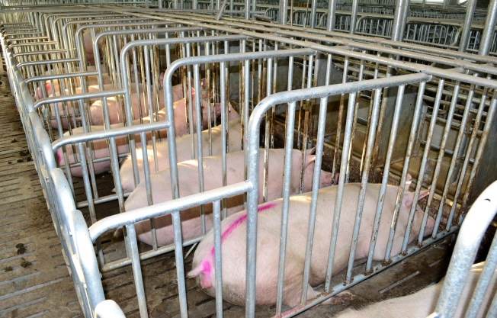
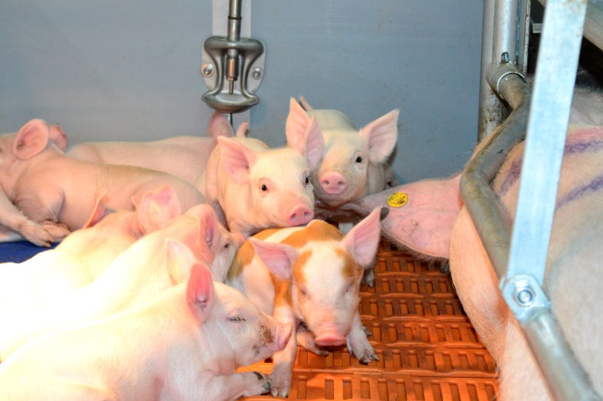
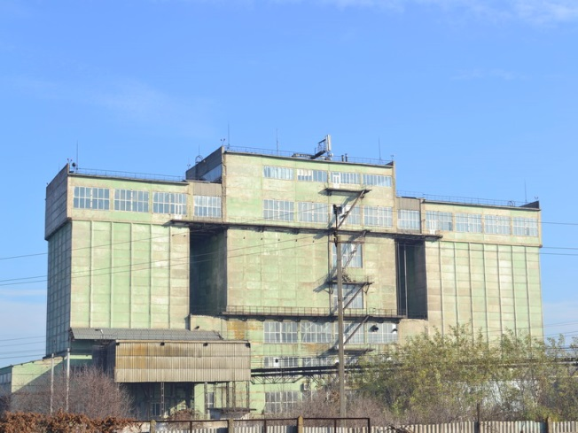
Pig breeding: facts
Pigs Breeding Sales
Pigs and piglets | 2019 | 2018 | 2017 | % | 2016 | 2015 | %
Total Sales, USD mln | 11,2 | 11,9 | 11,8 | 0% | 11,1 | 8,1 | 37%
Total Sales, tons | 9 400 | 9 802 | 9 810 | 0% | 10 547 | 7 785 | 35%
Total price USD/kg | 1,19 | 1,09 | 1,20 | 19% | 1,05 | 1,04 | 1%
In October 2013, a feed mill was purchased with a total area of 12,547.6 square meters and a maximum capacity of 61,200 tons a year.
So, 90% of the feed we produce on our own, which in turn reduces the cost.

Slide 8
Why in Ukraine:
Pig breeding business: new plans ahead
A group of investors headed by KSG Agro intends to create three breeding unit producers each with 2,000 heads in Ukraine for breeding and selling breeding animals:
A) Ukraine has a huge potential for increasing the pork population - accordingly, the acquisition of high-quality breeding animals with high genetic potential;
B) constant culling and replacement of the main breeding stock with large and medium-sized industrial enterprises.

Slide 9
Why now:
Pig breeding business: new plans ahead
1. The number of sows in Ukraine over the past 2 years has decreased by 20%.
2. Trade relations between countries in the next 3-5 years will be periodically “frozen” in connection with the quarantine on the African Swine Fever. For example, in China the number of pigs has decreased by half, which inflated prices by more than 70%.
3. In connection with bans on the importation of pork, bans on the import of breeding animals will be imposed, which accordingly will lead to a shortage of marketable pork and meat, as well as the aging of the main breeding stock and a decrease in the genetic potential of animals.

Slide 10
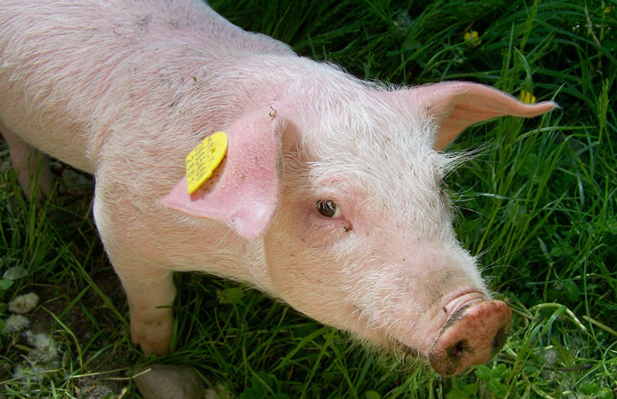
Why KSG Agro initiates the project:
Pig breeding business: new plans ahead
KSG Agro owns a farm that has experience in the industrial production of pork at its own facilities (a complex in the village of Niva Trudova for the production and sale in live weight - 110 thousand head of pigs per year).
Available capacity for the implementation of this project.
There is experience in breeding animals.

Slide 11
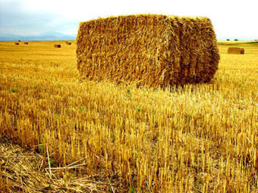
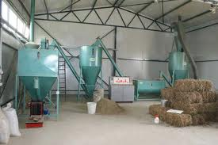
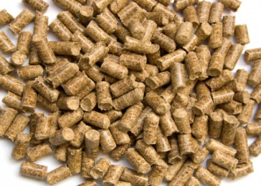
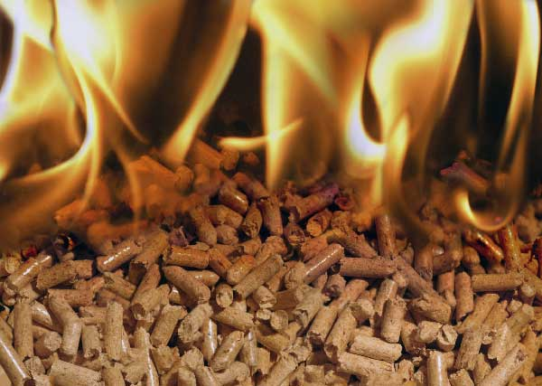
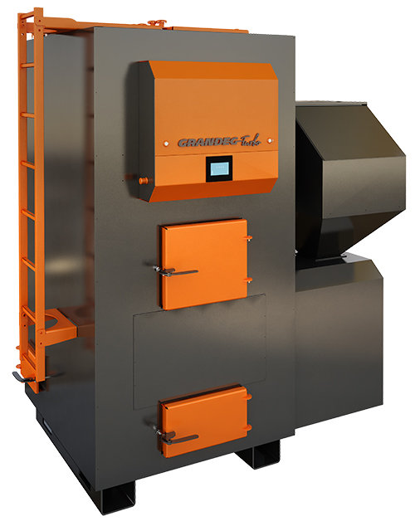
Fuel pellet & energy production: facts
Granules or pellets are a modern form of solid biofuels, which allow to fully automate the flow of fuel in boilers and optimize logistics significantly.
An operating pellet plant with a capacity of 2,400 tons a year in the village of Niva Trudova
The complete project foresees the construction of a new plant in the village of Kolomoytsevo, the proximity to the railroad tracks, full supply of electricity
A complete set of equipment for the new plant with a capacity of 60 thousand tons per year from the world's leading manufacturers: CPM, Cedrus, Aniro
At the moment, the Company operates:
  Pig Complex at Niva Trudova - 3 boiler houses (6 boilers of 500 kW each) - 3 MW - heat production for the heating season 200 days -1060 Gcal.
  School at Novopokrovka - boiler room - boiler 500 boiler 250 - 750 kW - heating season 180 days, heat production - 360 Gcal.
  School at Nadievka - boiler room 2 boilers of 350 - 750 kve each - heating season 180 days, heat production - 250 Gcal
  School at Zorya - boiler room 2 boilers of 250 and 350 kW - heating season 180 days, heat production - 230 Gcal
  School at Trituznoe - boiler room 2 boilers 250 and 250 - heating season 180 days, heat production - 200Gcal
  School at Nastasivka - boiler room 2 boilers 250 and 250 kW - heating season 180 days, heat production - 200Gcal
  Miriada Shopping Center - boiler house 2 boilers 500 kW and 300 kW - heating season for 180 days, heat production 300 Gal.

Slide 12
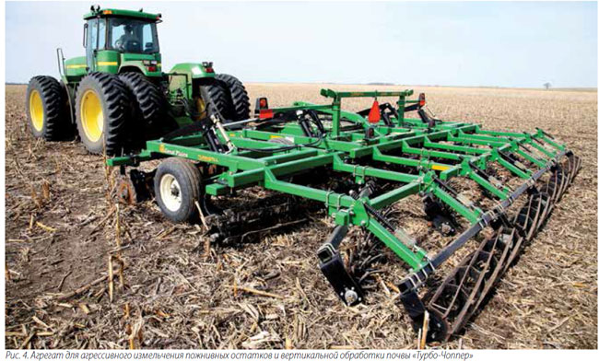
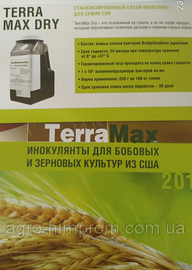
KSG Agro - Innovations for Increasing Operational Efficiency
Expansion of land areas, processed using the technology of vertical soil treatment (moisture retention+improved soil quality)
The use of bio-inoculants to increase the yield of soybeans and winter wheat (produced by the American company Terramax), as well as to save money on nitrogen fertilizers
The use in the cultivation of pigs feed own production with improved formulation, which gives an increase in weight gain, as well as cost savings

Slide 13



Location in the heart of the oil processing industry
The main oil-producing factories in the regions of presence
480
430
550
450
390
KSG Agro
850
Kernel
160
470
Bunge
Optimus
Creativ-Group
Cargill
450
Annual capacity of sunflower processing, thousand tons
Traditionally, sunflower is in high demand in Ukraine, caused by an overabundance of oil production capacity, which at the moment is about 10 million tons per year
The Company's lands are located in regions where about 40% of Ukrainian processing capacities are located. This allows the Company to benefit from a stable demand for sunflower
The Company benefits from favorable forward contracts for the supply of sunflower, according to which at the time of harvest the buyer pays the base price and the Company has the right to obtain the difference between the average market price for any date of the subsequent year and the base price paid
Notes:
We are certain about Excessive

Slide 14







Modern infrastructure
Availability of machinery and equipment
KSG Agro owns a fleet of agricultural machinery, consisting of more than 250 units, which is sufficient for processing the entire land bank of the Company
The company constantly renews its fleet to make sure we have the right means to harvest.
Grain storage capacity
The company controls floor granaries with a total capacity of about 40 thousand tons
The business model of the Company provides for increasing the storage capacity in proportion to the expansion of the land bank, in order to protect itself from seasonal fluctuations in prices for agricultural products

Slide 15

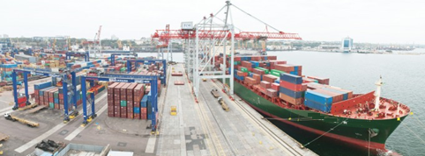
Abbondanza SA: the international trader of the Group
Exporting Ukrainian agro-commodities
The Group has established, since 2012, Abbondanza SA, the Company responsible for exporting Ukrainian agro-commodities produced by the Group's local subsidiaries as well as supplied by third parties Producers.
The products traded are: wheat (feed, milling, durum), barley, yellow maize, vegetable oilseeds, wheat flour. They are exported by sea, both in containers and in bulk vessel.
Abbondanza SA is strategically located in Lugano, Switzerland, between two of the most important European hubs of industrial and financial services: Milan and Lombardy in the South, Zurich Region in the North.
Since its inception, Abbondanza SA has experienced a progressive, solid growth.
The current markets wherein Abbondanza SA operates are: Italy, Sultanate of Oman, Angola.

