Slide 1


ARICOL group of companies, HALAL meat export aggregator

Slide 2
Aricol background
Aricol Limited Liability Company
Mature player on UA imported FMCG market, trusted and respected distributor for modern trade, traditional retail and B2B channels
Meat export management was an experiment project, targeted exclusively on Turkish government order. During the project four UA slaughterhouses were examined by Turkish veterinarians and granted Halal certificates under Aricol project management. As soon as certification part was successfully completed, those four slaughterhouses started to export to Et ve Süt Kurumu State Company under Aricol financial and executive management.
Despite Turkish project was paused due to the government decisions and policies, we are still interested in export (especially frozen meat) business, treating Ukraine as a strong agricultural country and potentially reliable and high quality meat exporter.

Slide 3
What we offer:
Frozen and chilled beef, corn fed and mix fed
Carcasses, split carcass sides and quarters, different types of cut
ISO, HAASP and HALAL certified
Logistics and delivery, FCA, CIF, your terms
Full set of documents
Reliable long-term partnership

Slide 4
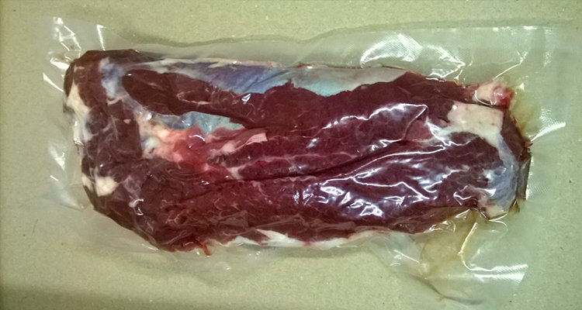
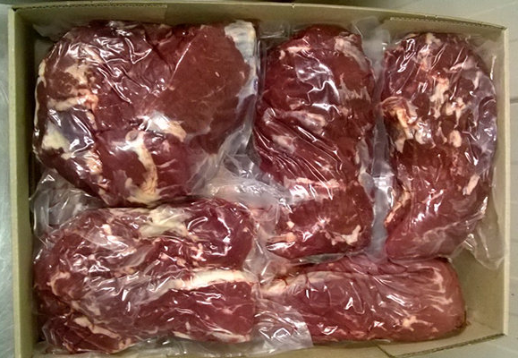
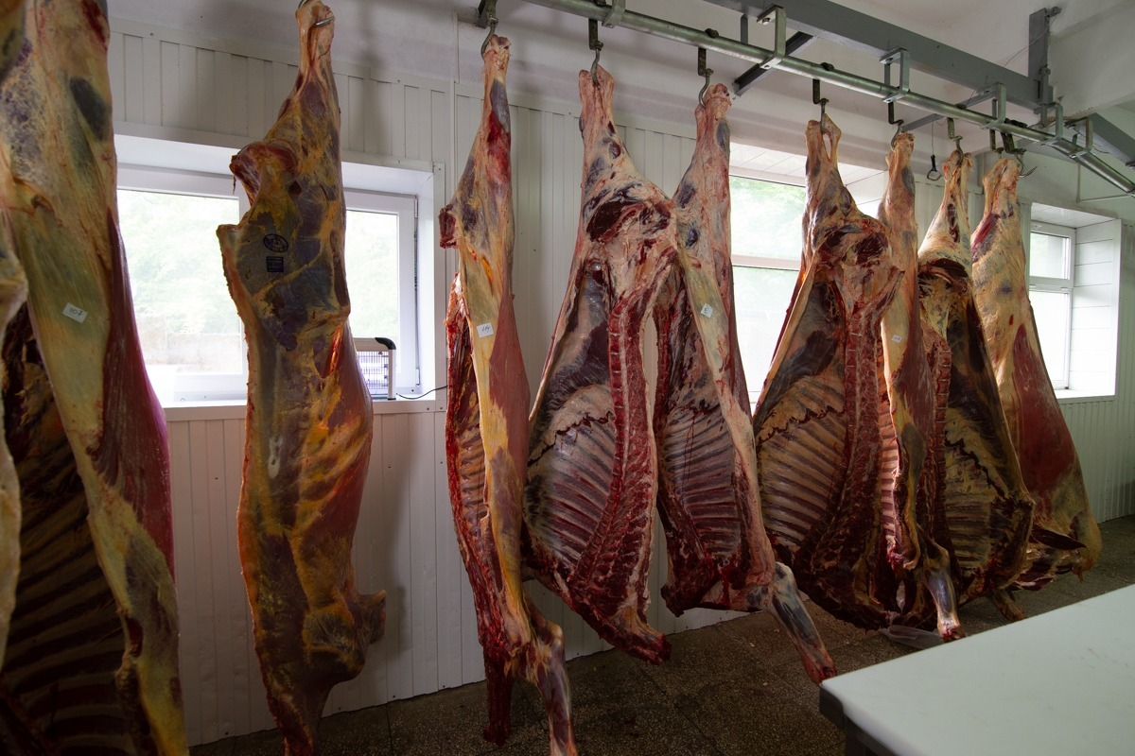
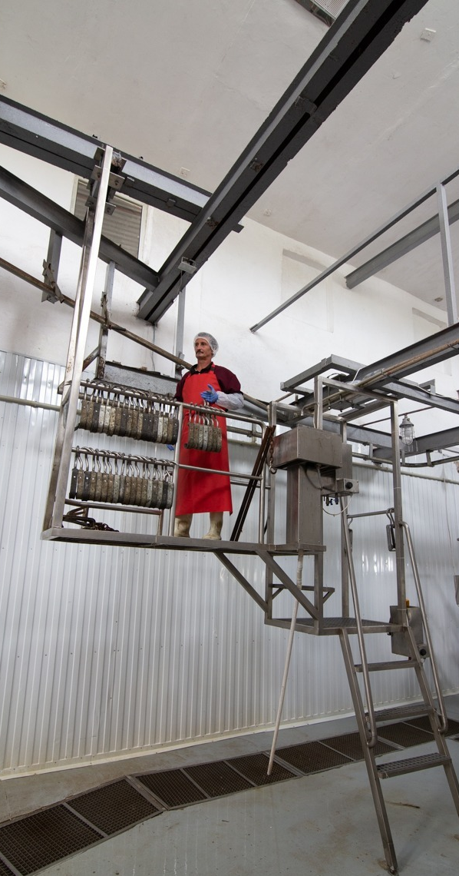
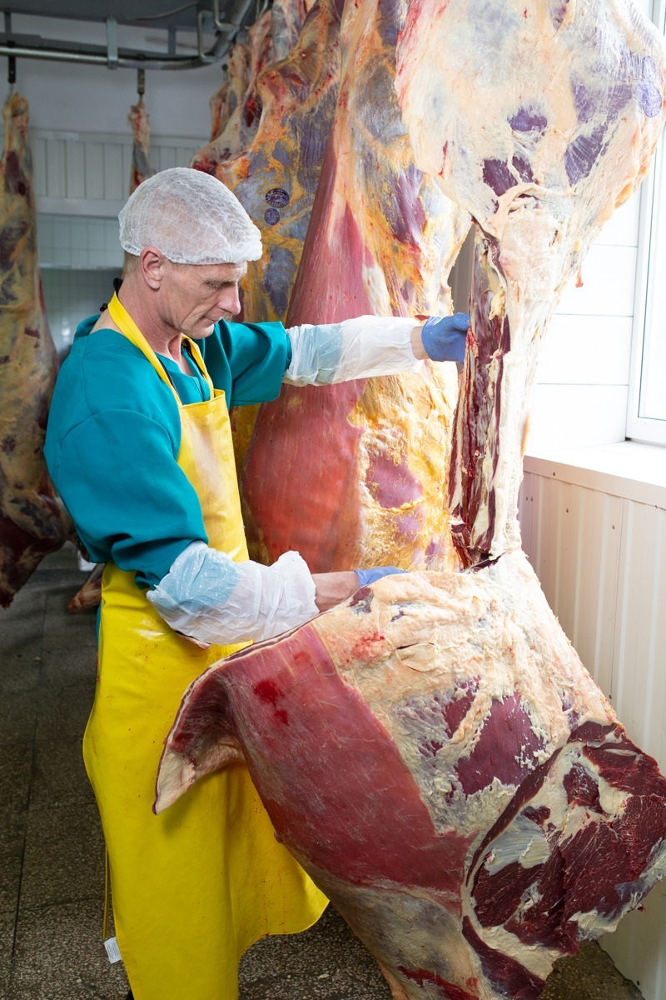
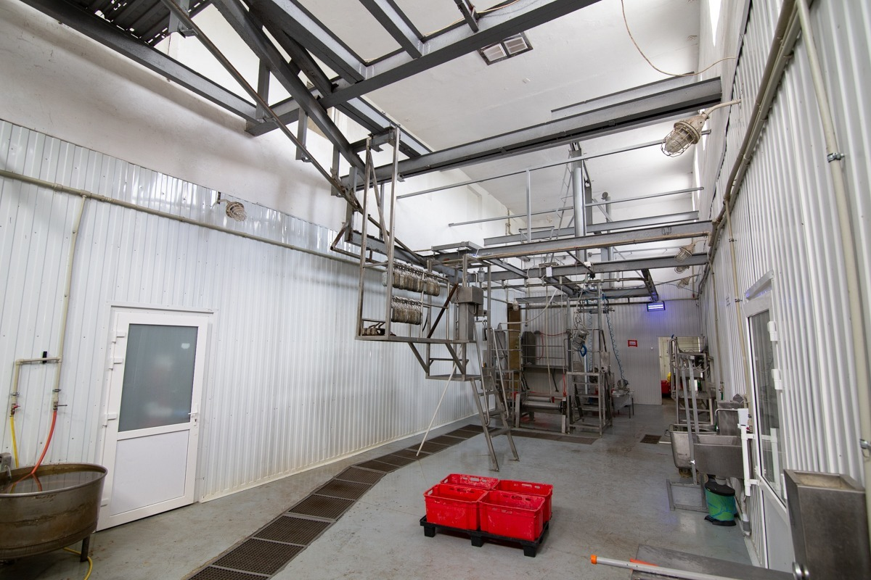
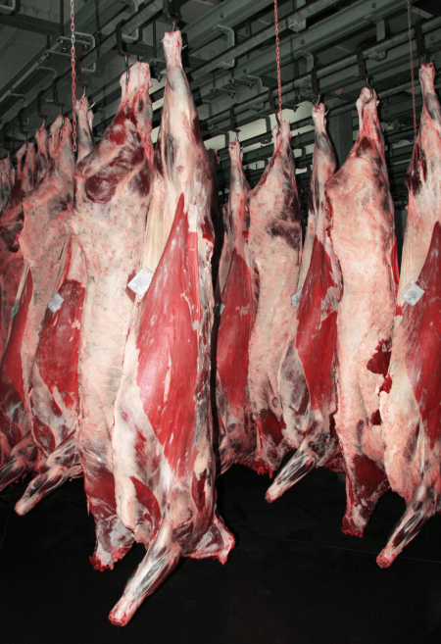
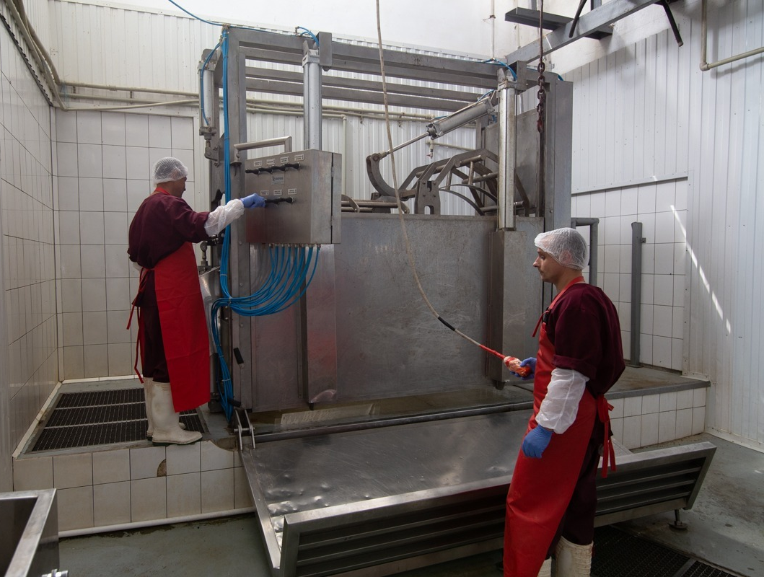

Slide 5
Our trusted partners:
Lider Product Plus LLC (was Halal certified under our control)
Koziatynskiy Miasokombinat LLC
Ternopil Meat Processing Plant
LubnyMyaso LLC (was Halal certified under our control)
Eco-Meat Polissya LLC (was Halal certified under our control)
Our business relationships and readiness to cooperate in Halal meat export is confirmed by the letter from every partner mentioned above.

Slide 6
Contacts:
BDM Alexey Dronov
A.Dronov@rutmart.com.ua
Alexey.Dronov@gmail.com
+380 50 3312009 (Viber, WhatsApp, WeChat)

