Slide 1
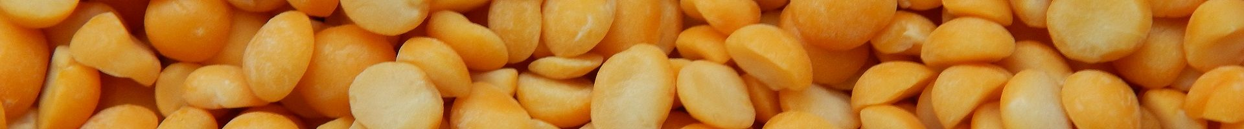
AGROPRIVAT LLC
Leading grocery manufacturer

Slide 2
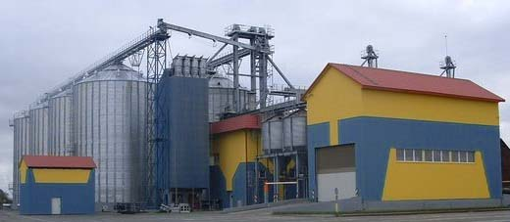
AgroPrivat llc - one of the leading manufacturers of hulled millet, yellow split peas, pearled barley and other grocery products in Ukraine.
The company on the market since 2003.
We are using the latest technology to improve the quality of our products. We produce more than 2000 tons of cereals and other products in a month.

Slide 3
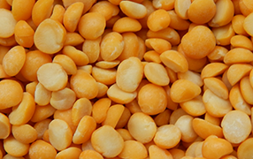
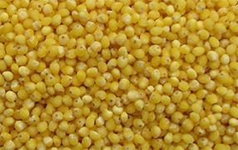
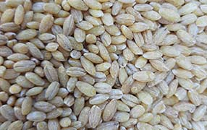
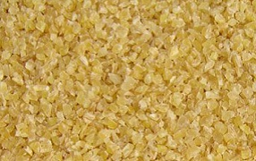
Our products:
Yellow split peas
High quality yellow split peas for human consumption.
Hulled millet
High quality hulled millet for human consumption.
Pearl barley
High quality pearl barley for processing or human consumption
Broken Durum wheat
Durum wheat cereal for human consumption.

Slide 4
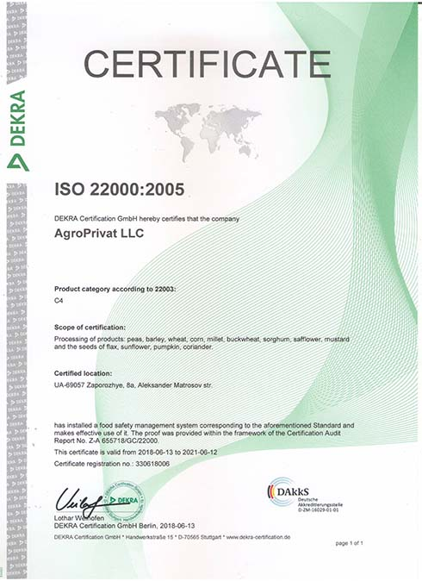
QUALITY:
The quality control department carries out a three-grade control - the quality of the received raw materials, in-process control and ready product control. All the products of our company have certificates of quality and are constantly passing laboratory tests.

Slide 5
Contacts:
Our address: 8a Olexander Matrosov street, Zaporizhzhia 69057, Ukraine
Tel.: +38 067 613 4855
Fax.: +38 061 769 2188
Skype: shvaikoil
WhatsApp.: +38 067 613 4855
Contact person:
Igor Shvaiko
Tel/WhatsApp: +38067-613-48-55

